Slide 1
Introduction to Economic Development

Slide 2
Overview
Economic Development 101
Primary and Secondary Employers
Seeing through Economic Development Glasses
Seeing through Primary Employer Glasses
Role of Elected Officials

Slide 3
Economic Development 101
A set of programs and policies that aid in the creation, retention and expansion of jobs; the development of a stable tax base; and the enhancement of wealth.
International Economic Development Council

Slide 4
Economic Development 101
Building Local Business
Business Recruitment
Small Business Development
Real Estate Development & Reuse
Workforce Development
Infrastructure
Credit Analysis
Finance Programs
Foreign Direct Investment & Exporting
Neighborhood Development
Technology-Led Development
International Economic Development Council

Slide 5
Economic Development 101
Building Local Business – Northwest Harvest
Business Recruitment – Ostrom Mushrooms
Small Business Development – Enterprise Challenge Business Plan Competition
Real Estate Development & Reuse – Rainier Square
Workforce Development – Up-Skill Back-Fill trainings
Infrastructure – Mill Site Roads, Utilities, and Interchanges
Neighborhood Development – Downtown Master Plan
Finance Programs – Industrial Revenue Bonds
Credit Analysis – Scale Up Workshops
Foreign Direct Investment & Exporting – Sister City Relationships
Technology-Led Development – Ag Innovation

Slide 6
Overview
Economic Development 101
Primary and Secondary Employers
Seeing through Economic Development Glasses
Seeing through Primary Employer Glasses
Role of Elected Officials

Slide 7
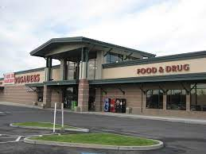
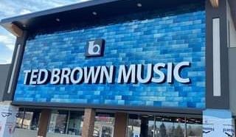
Primary & Secondary Employers

Slide 8
Primary & Secondary Employers
Primary employers are industries that produce more goods and/or services that can be consumed by the local economy and therefore export a significant portion of them.
Secondary employers are those businesses that serve the local community and essentially recirculate local dollars.
https://www.stevebizblog.com/primary-vs-secondary-employers/

Slide 9
Primary & Secondary Employers

Slide 10
Primary & Secondary Employers
What are the Top-5 Employing Industry Sectors in Yakima County?

Slide 11
Primary & Secondary Employers
What are the Top-5 Employing Industry Sectors in Yakima County?
Agriculture 26.6%
Government 15.7%
Health Care 14%
Retail Trade 9.6%
Manufacturing 7.5%
ESRI Community Analyst Online

Slide 12
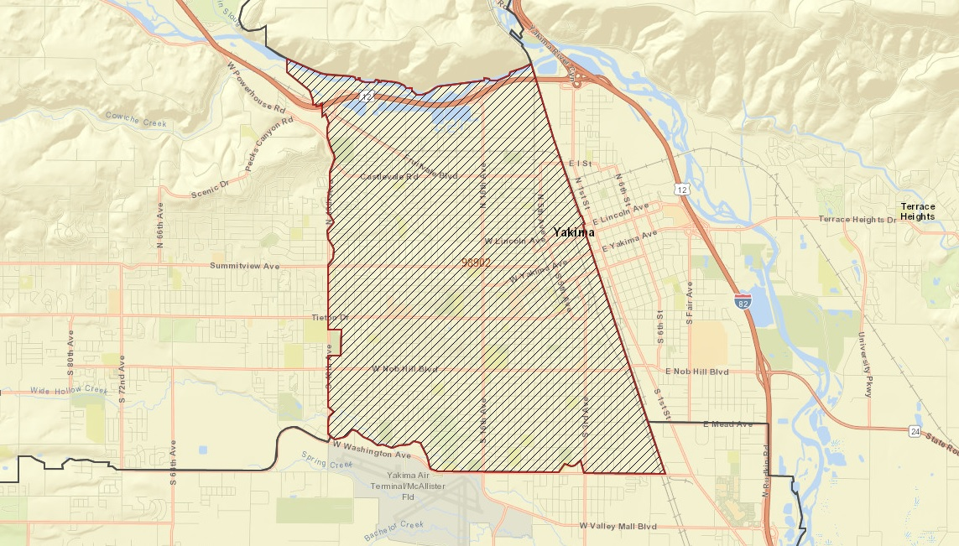
Primary & Secondary Employers
What are the Top-5 Employing Industry Sectors in Zip code 98902?

Slide 13
Primary & Secondary Employers
What are the Top-5 Employing Industry Sectors in Zip code 98902?
Health Care 34.2%
Wholesale Trade 10.2%
Retail Trade 8.2%
Educational Services 7.8%
Manufacturing 6.4%
ESRI Community Analyst Online

Slide 14
Primary & Secondary Employers
Jobs EQ 3.0

Slide 15
Primary & Secondary Employers
Direct - The jobs, sales/output and compensation directly created or lost by the event
Indirect - The jobs, sales/output and compensation created or lost by regional companies supplying goods and services to the new or newly expanded industry
Induced - The jobs, sales/output and compensation created when new employees from the new or expanded firm spend their wages at local establishments; or the jobs, sales/output and compensation lost when laid off employees do not spend their money locally anymore
Total - The sum of the direct, indirect and induced impacts
Jobs EQ 3.0

Slide 16
Primary & Secondary Employers
Jobs EQ 3.0

Slide 17
Overview
Economic Development 101
Primary and Secondary Employers
Seeing through Economic Development Glasses
Seeing through Primary Employer Glasses
Role of Elected Officials

Slide 18
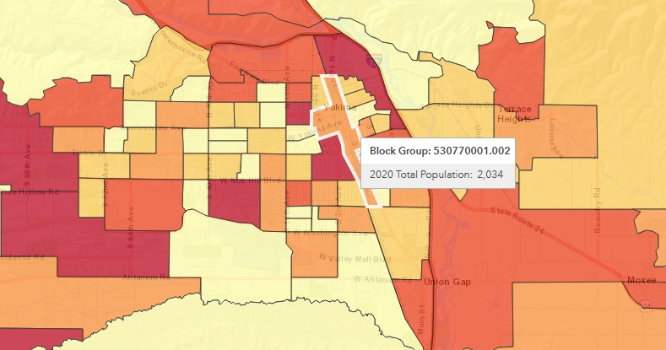
Economic Development Glasses
Population
ESRI Community Analyst Online

Slide 19
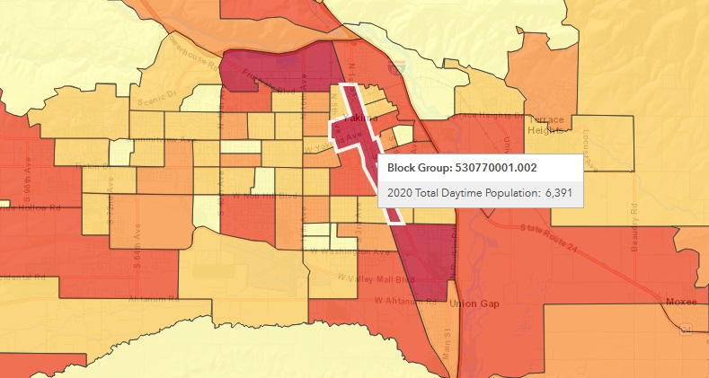
Economic Development Glasses
Daytime Population
ESRI Community Analyst Online

Slide 20
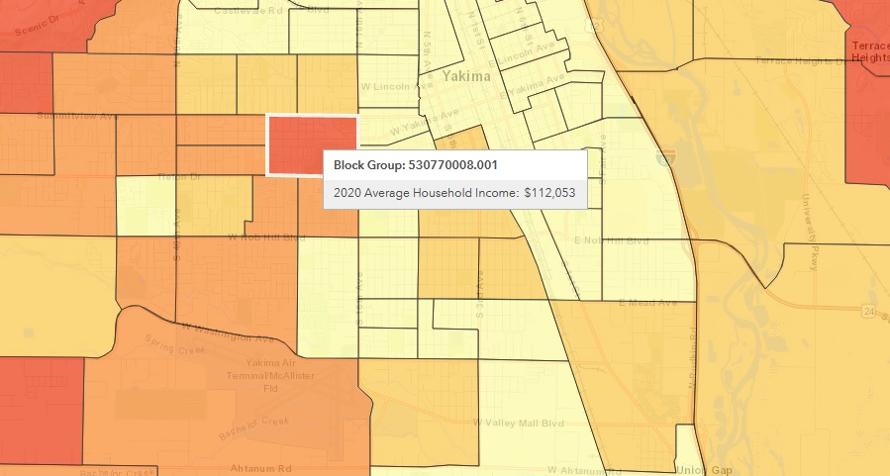
Economic Development Glasses
Average Household Income
ESRI Community Analyst Online

Slide 21
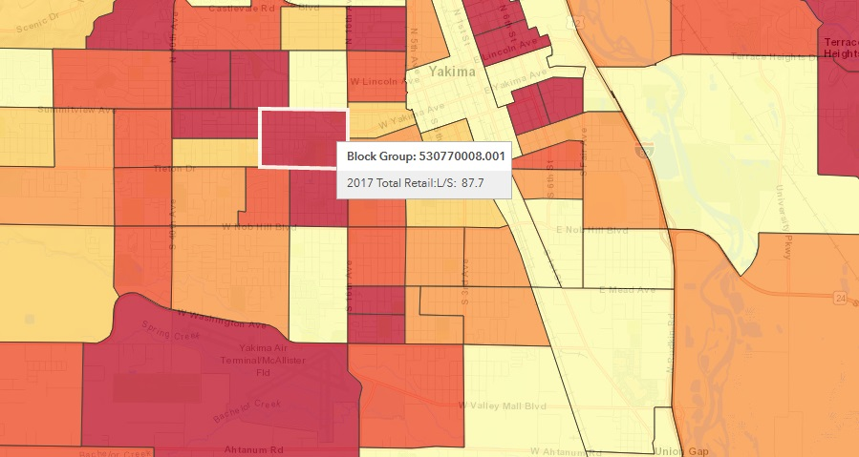
Economic Development Glasses
Retail Leakage
ESRI Community Analyst Online

Slide 22
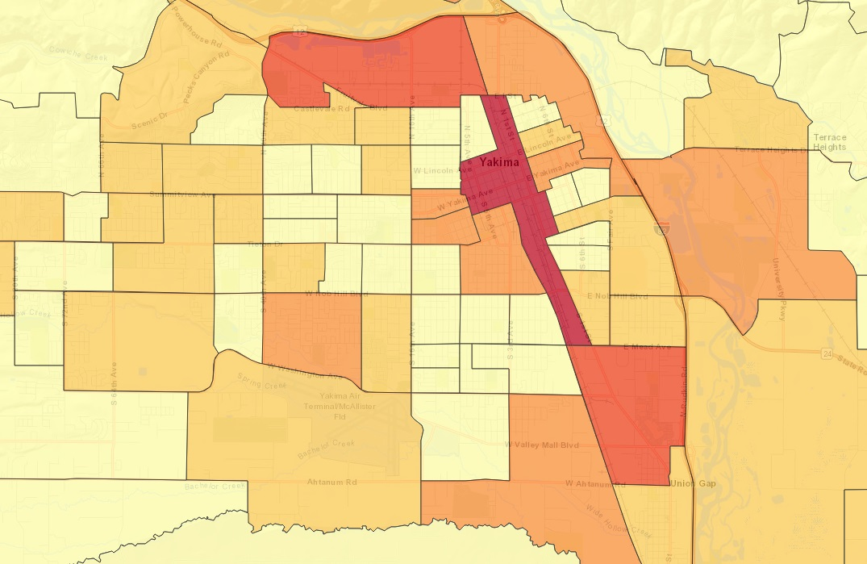
Economic Development Glasses
Number of Businesses
ESRI Community Analyst Online

Slide 23
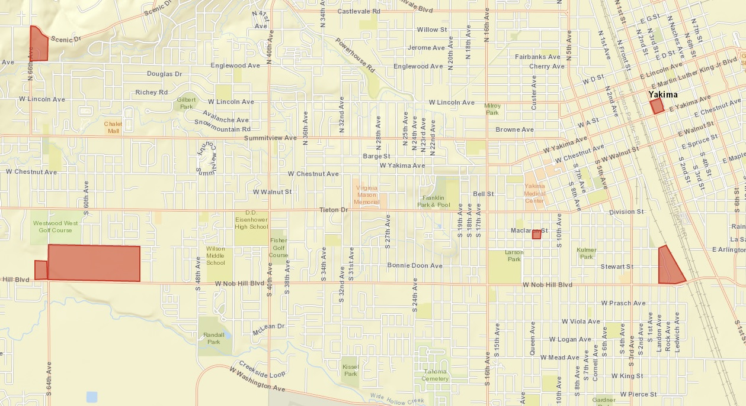
Economic Development Glasses
Value
Per Acre
Yakima County Assessor Office

Slide 24
Economic Development Glasses
$1,090,679
$2,440,702
Value
Per Acre
$722,800
$92,367
$2,700,179
$2,131,790
Yakima County Assessor Office

Slide 25
Overview
Economic Development 101
Primary and Secondary Employers
Seeing through Economic Development Glasses
Seeing through Primary Employer Glasses
Role of Elected Officials

Slide 26
Primary Employer Glasses
Lowest Upfront Cost
Lowest Long Term Cost

Slide 27
Primary Employer Glasses
What are the Top-4 Site Selection Factors?

Slide 28
Primary Employer Glasses
What are the Top-4 Site Selection Factors?
Skilled Labor
Highway Accessibility
Quality of Life
Construction Costs & Lease Rates

Slide 29
Overview
Economic Development 101
Primary and Secondary Employers
Seeing through Economic Development Glasses
Seeing through Primary Employer Glasses
Role of Elected Officials

Slide 30
Role of Elected Officials
RCW 35.21.703 and RCW 36.01.085 - Provides general authority for cities and counties to engage in economic development programs.
These statutes gives authority for cities and counties to contract with private nonprofit corporations for the purpose of engaging in economic development programs, assuming the underlying transaction is constitutional.
The statutes precludes cities from entering into contracts with for-profit corporations.

Slide 31
Role of Elected Officials
Economic Development Players

Slide 32
Role of Elected Officials
Associate Development Organizations
Department of Commerce
Port Districts
Counties and Cities
Chambers of Commerce
Small Business Development Centers
Public Facilities Districts
Downtown Associations
Community Development Finance Institutions
Colleges & Training Providers
Economic Development Players

Slide 33
Role of Elected Officials
BUSINESS
Department of Commerce
Associate Development Organization
City & County
Associate Development Organization
Department of Commerce
BUSINESS
Working as a Team

Slide 34
Role of Elected Officials
BUSINESS
Associate Development Organization
Colleges and Training Providers
County & City
BUSINESS
Working as a Team

Slide 35
Role of Elected Officials
Associate Development Organizations
Department of Commerce
Port Districts
Counties and Cities
Chambers of Commerce
Small Business Development Centers
Public Facilities Districts
Downtown Associations
Community Development Finance Institutions
Colleges & Training Providers
Economic Development Players

Slide 36
Role of Elected Officials
Local Strengths & Weaknesses
Place in the Broader Economy
Economic Development Vision and Goals
Strategy to Attain Goals
How Economic Development Works With Other Policies
Regulatory Environment
Stakeholders & Partners
Needs of Business Community
Economic Development Message
Economic Development Staff
What to
Know

Slide 37
Recap
Economic Development 101
Primary and Secondary Employers
Seeing through Economic Development Glasses
Seeing through Primary Employer Glasses
Role of Elected Officials

Slide 38
Final Thoughts
Magic is just someone spending more time on something than anyone else might reasonably expect.
Teller

Slide 39
Introduction to Economic Development

