Slide 1
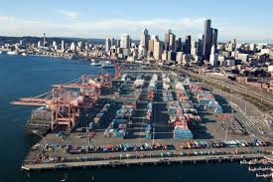
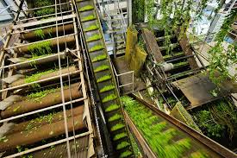
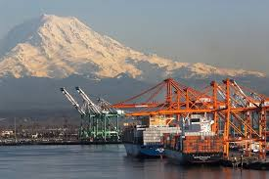
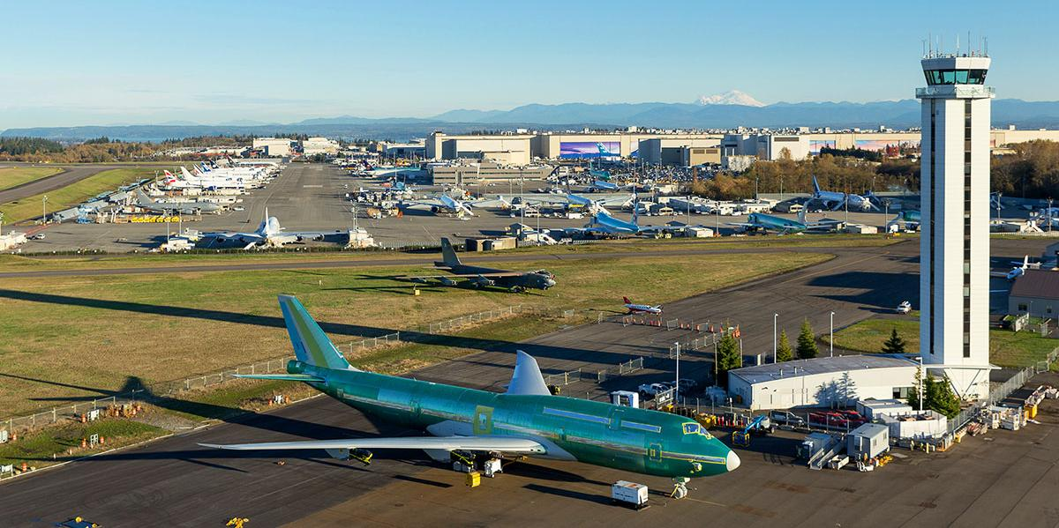
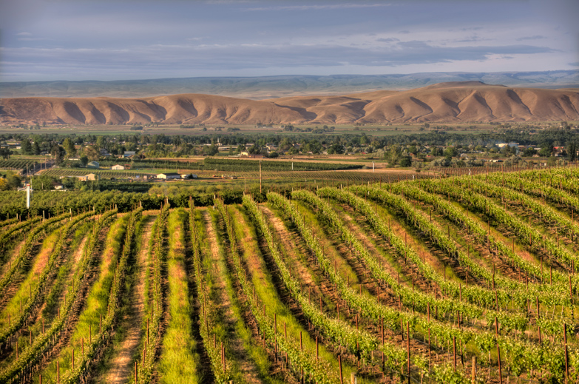
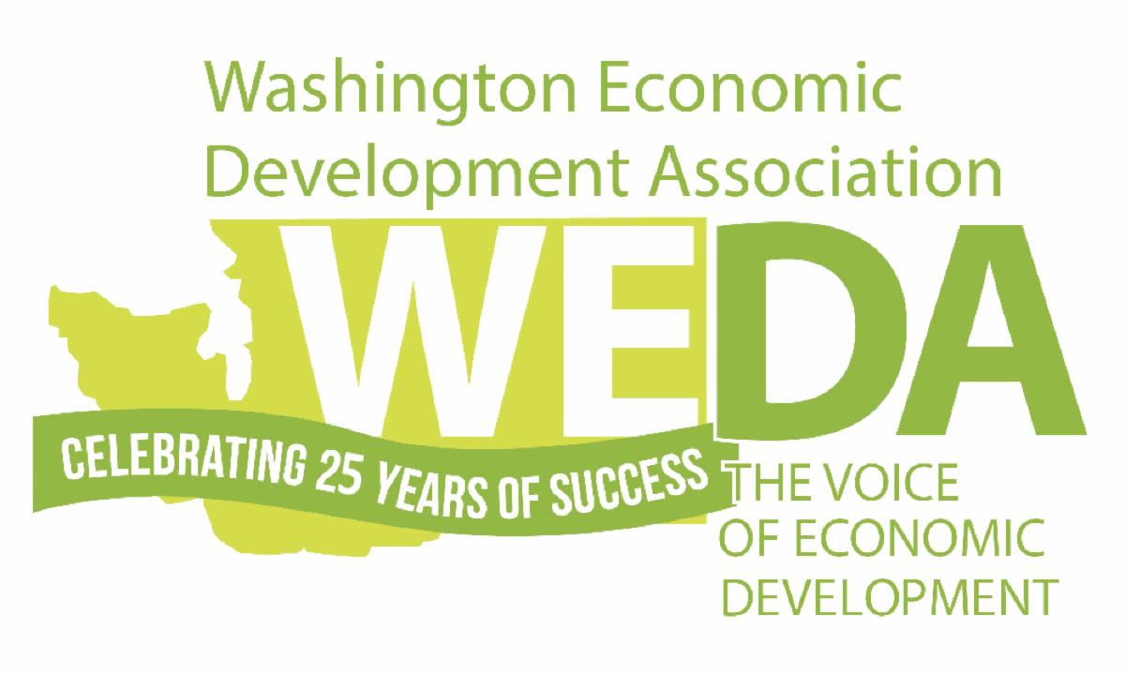
Working Together for Job Recovery & Economic Prosperity Across Washington Introduction to Economic Development During COVID-19 and Beyond
Chris Green, Assistant Director for Economic Development & Competitiveness, Washington State Department of Commerce
& WEDA Board Vice Chair
Gary Ballew, Director of Economic Development, Greater Spokane, Inc. & WEDA Board Incoming Chair
Suzanne Dale Estey, Executive Director, WEDA
Q4 2020

Slide 2
Introductions
About WEDA: Washington State’s only trade association laser-focused on economic development. WEDA is committed to recovering, retaining, expanding and recruiting jobs and investment in Washington
Our Strategic Goals – since COVID-19: Creating an imperative to empower communities across Washington with tools to recover from the COVID-19 crisis, assisting employers large and small in rebuilding, becoming globally competitive and growing jobs, while supporting an equitable economy and inclusive economic development.
We Believe: The time is now to rebuild our economic vitality, increase the resiliency of our economy, and strengthen the economic development ecosystem at state, regional and local levels.
About Washington Commerce: Work with local governments, tribes, business and civic leaders to strengthen communities across our state
Key Sector Strategy; Business Recruitment & Expansion; Small Business Services
About Greater Spokane, Inc. and the State’s Associate Development Organizations/Economic Development Councils
39 counties covered by 34 ADOs; public-private partnerships; conveners & catalysts; cluster-driven, confidential client focus

Slide 3
Defining Economic Development
No single definition for economic development, and no single strategy, policy, or program for achieving successful economic development.
Typically described in terms of objectives. Most commonly described as: creation of jobs and wealth, and the improvement of quality of life.
Can also be described as a process that influences growth and restructuring of an economy to enhance the economic well being of a community.
Economic development encompasses three major areas:
Policies to meet broad economic objectives including inflation control, high employment, and sustainable growth.
Policies and programs to provide services – building infrastructure and providing assistance to the disadvantaged.
Policies and programs directed at improving the business climate through specific efforts – business finance, marketing, neighborhood development, business retention/expansion, technology transfer, real estate development.
From: www.iedconline.org/clientuploads/Downloads/IEDC_ED_Reference_Guide.pdf

Slide 4
Defining Economic Development
Harvard Professor Michael E. Porter: long-term process of building a number of interdependent microeconomic capabilities and incentives to support more advanced forms of competition.
Wikipedia: Economic development generally refers to the sustained, concerted actions of policymakers and communities that promote the standard of living and economic health of a specific area. Such actions can involve multiple areas including development of human capital, critical infrastructure, regional competitiveness, environmental sustainability, social inclusion, health, safety, literacy, and other initiatives.
Main goal: improving the economic well being of a community through efforts that entail job creation, job retention, tax base enhancements and quality of life.
Communities differ in their geographic and political strengths and weaknesses. Each community will have a unique set of challenges and strategies for economic development.

Slide 5
Limitations on Economic Development in Washington
Due to strict limitations in the Washington State Constitution, governments in Washington State have very few avenues open for direct participation in private economic development projects.
State of Washington is one of the more restrictive in the nation on how public funds may be used to attract private investment.
Potential legal issues regarding the loaning or gifting of public funds. Under Article 8, Section 7 of the Washington State Constitution, a city or county may not directly give or loan money to private businesses for economic development. Specifically, Article 8, Section 7 of the state constitution provides:
No county, city, town or other municipal corporation shall hereafter give any money, property, or loan its money, or credit to or in aid of any individual, association, company or corporation, except for the necessary support of the poor and infirm.
This constitutional provision, which is found in many state constitutions, has been interpreted in numerous cases and generally has been interpreted very narrowly in regard to allowable uses of public funds to aid private businesses or corporations.
Some exceptions during COVID-19 due to emergency status. Washington Attorney General Opinions (March 17, 2020 and April 6, 2020)

Slide 6
Many Partners in the Economic Development Ecosystem
Washington State Department of Commerce, including Industry Sector Leads
Other State & Federal Agencies
Associate Development Organizations/Economic Development Councils
Ports (some are Associate Development Organizations)
Counties
Cities
Tribes
Universities
Workforce development partners
State industry cluster/trade associations (AFA, WTIA, LSW, WA Maritime Blue)
Association of Washington Business, Washington Roundtable, local Chambers of Commerce, private businesses, banks and Community Develop. Financial Institutions
Washington Small Business Development Center and US Small Business Administration
Utilities & Railroads
Other coalitions/regional EDOs/Economic Development Districts/MPOs
Labor partners
And many more: Visitor & Convention Bureaus, redevelopment agencies, Impact Washington, incubators

Slide 7
Economic Development Strategies
Business Retention/Recovery & Expansion - #1 economic development activity
Business Recruitment/Site Selection
Industry Clusters
Small Business Development
Entrepreneurship/Venture Capital
Economic Development Finance
Incentives
Downtown Development
E-Commerce
Infrastructure
Real Estate Redevelopment
Economic Development Marketing/Shop Local Campaigns
Rural Economic Development
Tourism
Neighborhood Economic/Community Development
Export/Trade Development
Workforce Development
Other: Regulatory/Business Climate Improvements, Quality of Life, Smart Growth, Sustainable Development, Brownfields

Slide 8
Common Local Government Economic Development Strategies
Infrastructure Development - #1 economic development tool in Washington State
Infrastructure may be in advance – “build it and they will come”
In response to an opportunity/project but will support other development
Capacity building
CERB/PWTF/LRF/EDA/.09 – working on TIF
Permit Streamlining/Permit Assistance
Streamlining often identifies bottlenecks in process and removes
Assistance helps proposed development meet codes
Still have to meet all the rules
Code Alignment
Make sure local government goals align with local government codes
Downtown Revitalization
Most municipalities take action to encourage investments in their downtown

Slide 9
Business Retention/Recovery & Expansion
Activities:
COVID-19 and other grants
Low interest loans – purchase of buildings, new equipment
Tax credits
Use of zoning, permitting assistance
Workforce training and assistance
Industry cluster strategies
Periodic surveys, interviews & visits/relationship building
Benchmarking
Quantitative Measures:
Number of Jobs recovered/retained/created
Number of Retained Businesses
Number of Businesses visited; % of Jobs Held by Local Residents; Avg. Salary
Qualitative Measures:
Business perceptions of local government, community
Involvement of assisted businesses in community/government

Slide 10
Business Retention/Recovery & Expansion Resources
US Department of Commerce
US Department of Commerce International Trade Administration
US Small Business Administration
Washington Small Business Development Centers
Business Retention & Expansion International (BREI)
Washington State Department of Commerce
Local Associate Development Organization
Washington Commerce Small Business Resiliency Partners
Washington Business Hub

Slide 11
Business Recruitment/Site Selection
Activities:
Online marketing
Trades shows
Rapid response to data inquiries
Leveraging of utility infrastructure
Resources:
Area Development Magazine
Business Development Outlook Magazine
Business Facilities Magazine
Expansion Management Magazine
Site Selection Magazine
http://choosewashingtonstate.com/

Slide 12
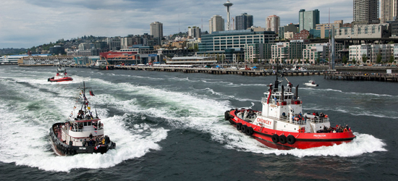
Industry Clusters/Sectors
Washington State Key Sectors
Aerospace
Agriculture & Food Manufacturing
Clean Technology
Forest Products
Information & Communications Technology
Life Science/Global Health
Maritime
Military & Defense
Activities
Shared workforce development strategies
Attracting Research & Development funding
Identifying gaps in ecosystem
Leveraging investment/venture funding

Slide 13
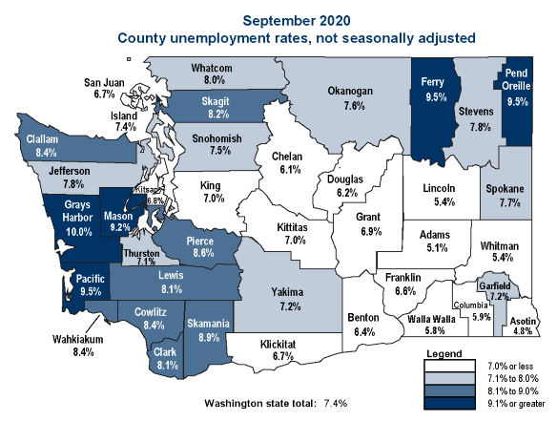
Economic Crisis is Statewide
US Rate:
7.9%
WA State Rate:
7.4%
Source: WA State ESD

Slide 14
Washington Commerce

Slide 15
Washington Commerce
Key Sector Strategy
Targeted industries that can spur rapid growth
Business Recruitment & Expansion/choosewashington.com
Business Development Team
Foreign Investment & Export Assistance
International Missions & Trade Shows
Tourism
Small Business Services
Education
Technical Assistance
Entrepreneur Resources/StartUp Washington
Business Grants & Loans
Economic Partnerships & Economic Resiliency Partners

Slide 16
Economic Recovery Dashboard

Slide 17
Key COVID-19 Resources
Economic Recovery Dashboard
www.coronavirus.wa.gov/
Working Washington Small Business Grants – Round 2
Small Business Resiliency Assistance
Nonprofit Grant Assistance Program
County-by-County Business Resources
Washington Small Business Development Centers
AWB Rebound & Recovery Resources
Manufacturing Industry Resources
US Small Business Administration
USDA Resources - Rural Development & Agriculture

Slide 18
WEDA’s Top Priorities
WEDA’s advocacy focuses on the most critical actions policymakers can take to recover, retain and grow living wage jobs, foster vibrant communities, support equity and opportunity for all and spark investment across Washington State:
Strengthen the Economic Development Ecosystem
Foster Catalysts for Job Recovery & Growth
Increasing Prosperity for All of Washington

Slide 19
Let’s Connect
Suzanne Dale Estey
Executive Director
Washington Economic Development Association
206-769-4217
suzanne@wedaonline.org
www.wedaonline.org
/WashingtonEconomicDevelopmentAssociation
/company/washington-economic-development-association/
@WashingtonEcon1
Chris Green
Assistant Director
Washington State Department of Commerce
206-256-6146
chris.green@commerce.wa.gov
Gary Ballew
Vice President of Economic Development
Greater Spokane, Inc.
509-321-3634
gballew@greaterspokane.org

