Slide 1
Introduction to Economic Development
Jonathan Smith, CEcD
Yakima County Development Association

Slide 2
International Economic Development Council
A set of programs and policies that aid in the creation, retention and expansion of jobs; the development of a stable tax base; and the enhancement of wealth.

Slide 3
International Economic Development Council
Building Local Business
Business Recruitment
Small Business Development
Real Estate Development & Reuse
Workforce Development
Infrastructure
Credit Analysis
Finance Programs
Foreign Direct Investment & Exporting
Neighborhood Development
Technology-Led Development
Notes:
Assess your needs, consider the cost of outsourcing vs. in house work. Staff time is not free.

Slide 4
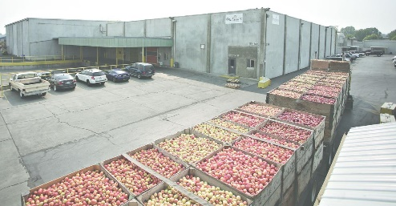
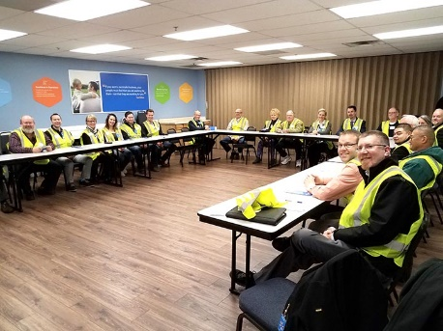
Primary Employers
FruitSmart
WalMart Distribution Center
Bleyhl
Co-Op

Slide 5
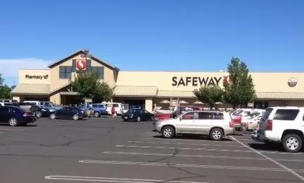
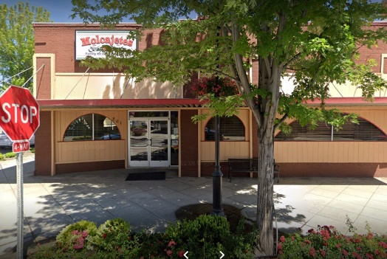
Secondary Employers
SafeWay
Molcajetes
Dollar Tree

Slide 6
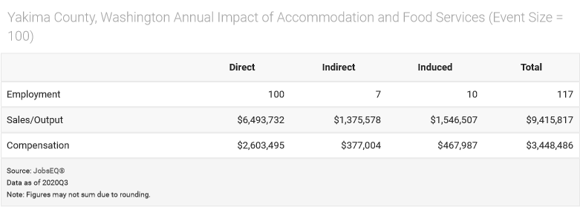
Primary & Secondary Employers

Slide 7
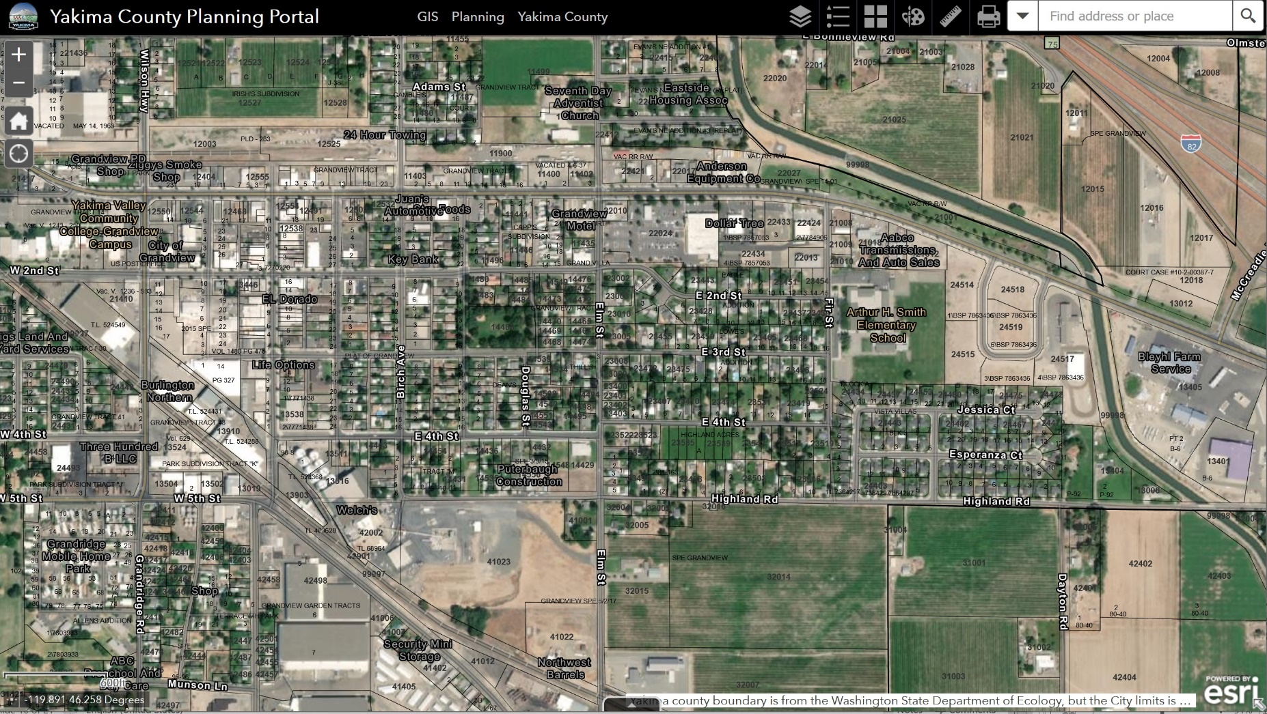
See Your Community Through Economic Development Glasses

Slide 8
See Your Community Through Economic Development Glasses

Slide 9
See Your Community Through Economic Development Glasses
$29
per acre

Slide 10
See Your Community Through Economic Development Glasses
$289
per acre
$29
per acre

Slide 11
See Your Community Through Economic Development Glasses
$289
per acre
$546
per acre
$29
per acre

Slide 12
See Your Community Through Economic Development Glasses
$289
per acre
$2,521
per acre
$546
per acre
$29
per acre

Slide 13
See Your Community Through Economic Development Glasses
$2,646
per acre
$289
per acre
$2,521
per acre
$546
per acre
$29
per acre

Slide 14
See Your Community Through Economic Development Glasses
$2,646
per acre
$289
per acre
$2,521
per acre
$3,292
per acre
$546
per acre
$29
per acre

Slide 15
See Your Community Through Economic Development Glasses
$2,646
per acre
$3,559
per acre
$289
per acre
$2,521
per acre
$3,292
per acre
$546
per acre
$29
per acre

Slide 16
What are the Top-5 Employing Industry Sectors in Yakima County?
Pop Quiz!

Slide 17
Agriculture 26.6%
Government 15.7%
Health Care & Social Assistance 14%
Retail Trade 9.6%
Manufacturing 7.5%
What are the Top-5 Employing Industry Sectors in Yakima County?
Pop Quiz!

Slide 18
What are the Top-5 Employing Industry Sectors in the Grandview Zipcode?
Pop Quiz!

Slide 19
Agriculture 28.9%
Transportation and Warehousing 22.1%
Educational Services 10.6%
Retail Trade 9.4%
Health Care 8.4%
What are the Top-5 Employing Industry Sectors in the Grandview Zipcode?
Pop Quiz!

Slide 20
Economic Development Landscape
RCW 35.21.703 and RCW 36.01.085 - Provides general authority for cities and counties to engage in economic development programs.
These statutes gives authority for cities and counties to contract with private nonprofit corporations for the purpose of engaging in economic development programs, assuming the underlying transaction is constitutional.
The statutes precludes cities from entering into contracts with for-profit corporations.

Slide 21
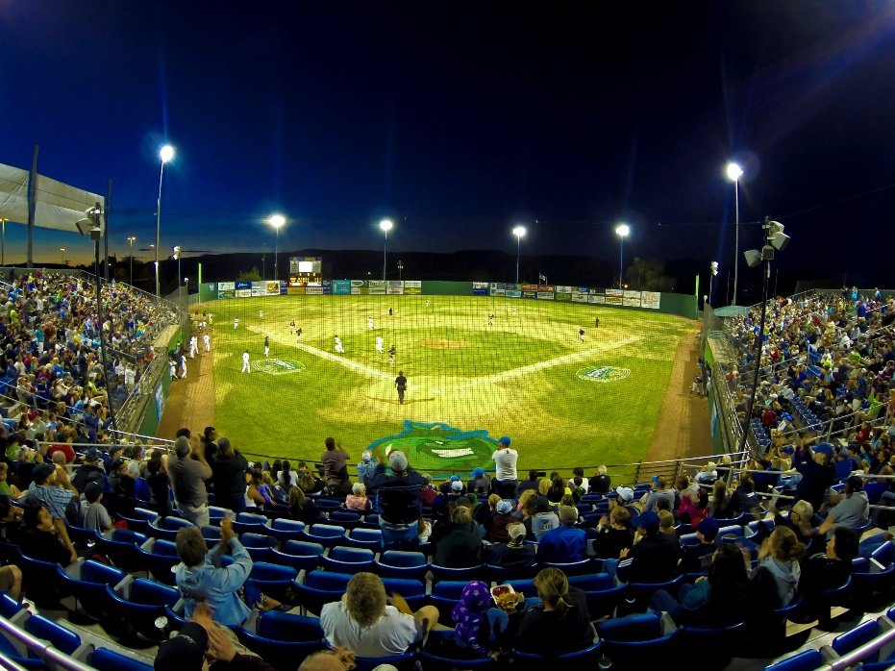
Economic Development Landscape

Slide 22
Economic Development Players
Associate Development Organizations
Department of Commerce
Port Districts
Counties and Cities
Chambers of Commerce
Small Business Development Centers
Public Facilities Districts
Downtown Associations
Community Development Finance Institutions
Colleges & Training Providers

Slide 23
How Players Work as a Team
BUSINESS PROJECT
Department of Commerce
Associate Development Organization
City & County
Associate Development Organization
Department of Commerce
BUSINESS PROJECT

Slide 24
What are the Top-4 Site Selection Factors?
Pop Quiz Part 2!

Slide 25
Skilled Labor
Highway Accessibility
Quality of Life
Construction Costs & Lease Rates
What are the Top-4 Site Selection Factors?
Pop Quiz Part 2!

Slide 26
What Elected Officials Should Know
Local Strengths & Weaknesses
Place in the Broader Economy
Economic Development Vision and Goals
Strategy to Attain Goals
How Economic Development Works With Other Policies
Regulatory Environment
Stakeholders & Partners
Needs of Business Community
Economic Development Message
Economic Development Staff

Slide 27
It Doesn't Just Happen
Magic is just someone spending more time on something than anyone else might reasonably expect.
Teller

